Slide 1
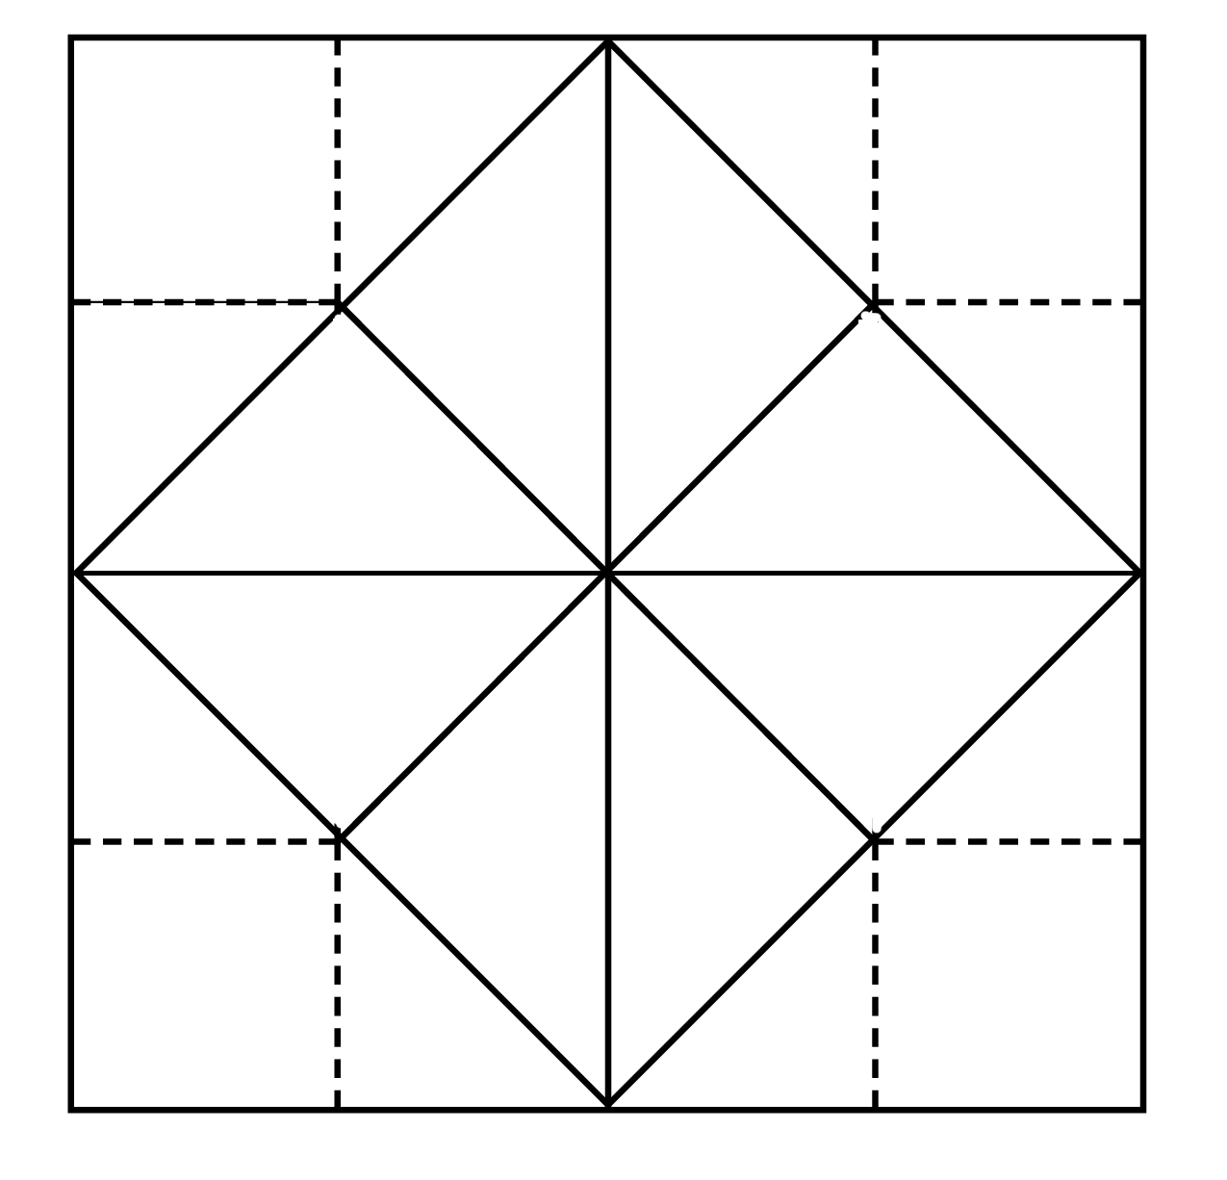
Directions: Use this resource with your Learn360 subscription. Type the item #s into your search bar to discover content.
Log In now: https://learn360.infobase.com/
Not a subscriber? Get a FREE Trial: infobase.com/free-trial
Literature
Math
Student
What Makes Sense and Sensibility a Classic? (Literature Classics), 285511
Librarian
Probability Fair, 276657
Media
Literacy
How Do Journalists Verify News?— My World Media Literacy, 209885
Technology
Science Kids: Robots and Artificial Intelligence, 289533
What Is Inflation? (Financial Literacy)
290314
Investigating Plants,
211458
Financial Literacy
Cute and Clever Writing Craftivities, 211206
The Littlest Mermaid (Spanish), 282261
Science
Admin
Teacher
Art
Spanish
© 2024 Infobase Holdings, Inc. All rights reserved. • www.infobase.com

Slide 2
Directions: Use this resource with your Learn360 subscription. Type the Topic Center name into the search bar and scroll to the target icon to discover Topic Centers.
Log In now: https://learn360.infobase.com/
Directions: Use this resource with your Learn360 subscription. Type the Topic Center name into your search bar and scroll to the target icon to discover Topic Centers.
Not a subscriber? Get a FREE Trial: infobase.com/free-trial
Student
Literature
Math
Librarian
Literature
Multiplication
Media
Literacy
Technology
Media Literacy
Technology and Innovation
Financial Literacy
Plant Life Cycle and Adaptation
Financial Literacy
Bilingual Spanish Storybooks
Art
Science
Admin
Teacher
Art
Spanish
© 2024 Infobase Holdings, Inc. All rights reserved. • www.infobase.com

Slide 3
Directions: Use this resource with your Learn360 subscription.
Log In now: https://learn360.infobase.com/
Directions: Use this resource with your Learn360 subscription. Type the Topic Center name into your search bar and scroll to the target icon to discover Topic Centers.
Not a subscriber? Get a FREE Trial: infobase.com/free-trial
© 2024 Infobase Holdings, Inc. All rights reserved. • www.infobase.com

