Slide 2
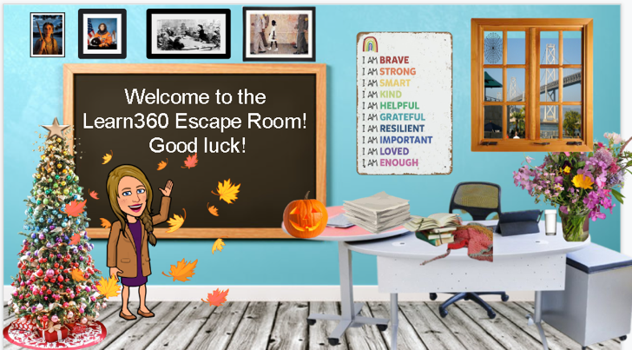
Agenda
Introduction
Goals
Escape Room: Learn360 and Classroom Video (CVOD)
How to Create an Escape Room
Ideas for Student- Created Escape Rooms
Item #s

Slide 3
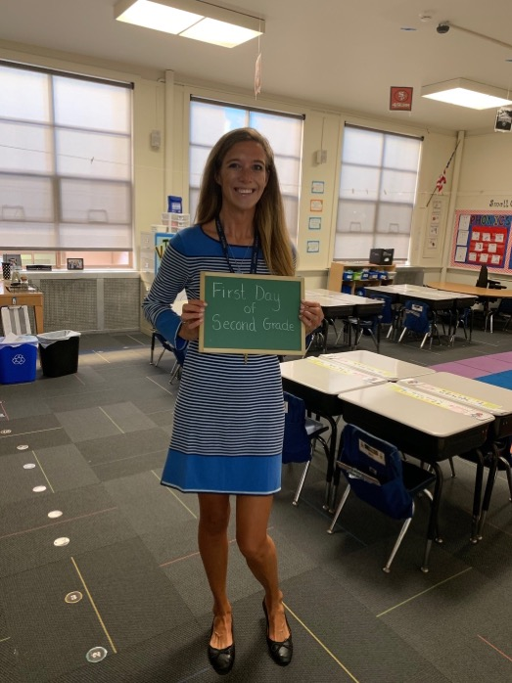
Introduction
Emily Ice, K-12 Video Acquisition Manager
Former 2nd Grade/ 3rd Grade Teacher
eice@infobase.com

Slide 4
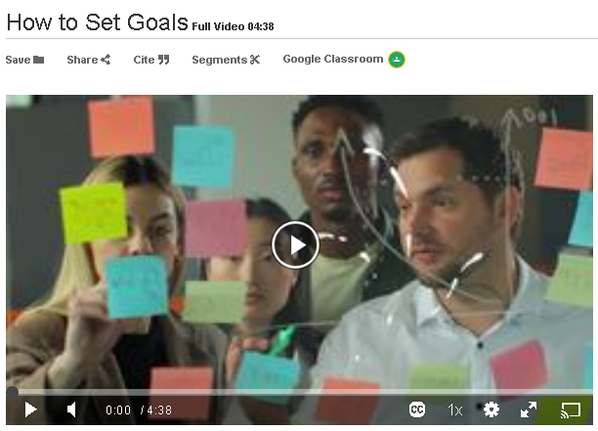
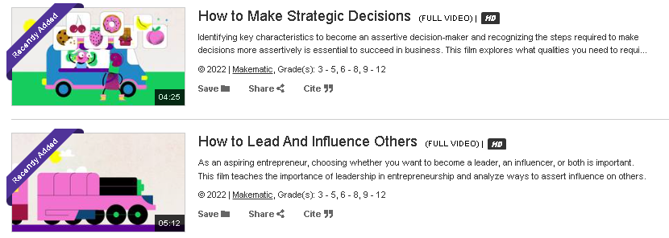
Goals
Attendees (Students) will be able:
to utilize search features to locate multimedia content in Learn360 and CVOD.
to create Escape the Rooms
to generate ideas for the use of escape rooms in the classroom.
to list item numbers of recently added and popular content to Learn360 and CVOD

Slide 5
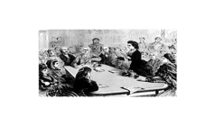
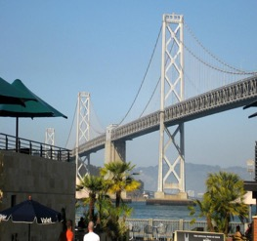
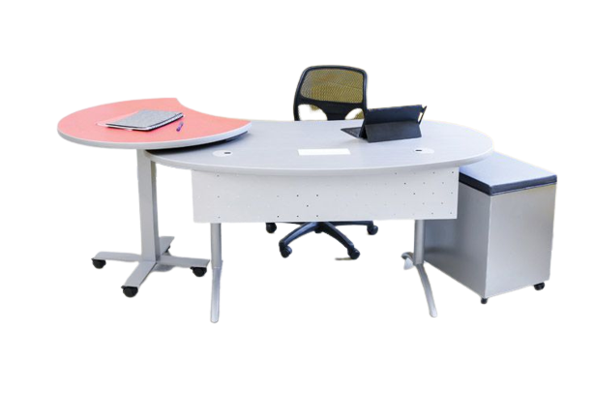
Welcome to the Learn360 Escape Room!
Good luck!

Slide 6
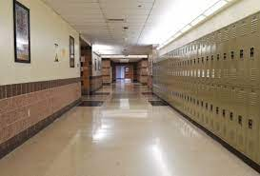
To escape, you will need access to:
Learn360 and Classroom Video On Demand.
Use your own school account or
get a FREE TRIAL
You will also need a piece of paper and a pen/pencil.
Click the EXIT SIGN to advance

Slide 7
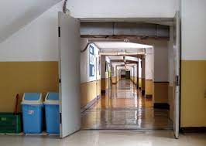
Instructions:
Each puzzle will require you to write your answer in the blank ___.
Each question will have blanks with the exact number of letters in the answer (like hangman).
Some of these letters in the answer will have parentheses (___).
As you solve each puzzle, you will need to write down on a piece of paper any letters that are in (___).
These letters will need to be unscrambled at the end to solve the final escape puzzle!
Good luck escaping!

Slide 8
1. What is the title of Makematic’s 2021 Halloween title?
__ (__) __ __ __ __ and Festivals: Halloween
Clue #1

Slide 9
Clue #1
Directions:
Open Learn360
The key to unlocking this puzzle is to find the most recent Halloween content
Search “Halloween”
Filter by Producer.
You want to find the most recent videos, so sort results by NEWEST to OLDEST.
Hint: The producer and copyright year is listed under the image.

Slide 10
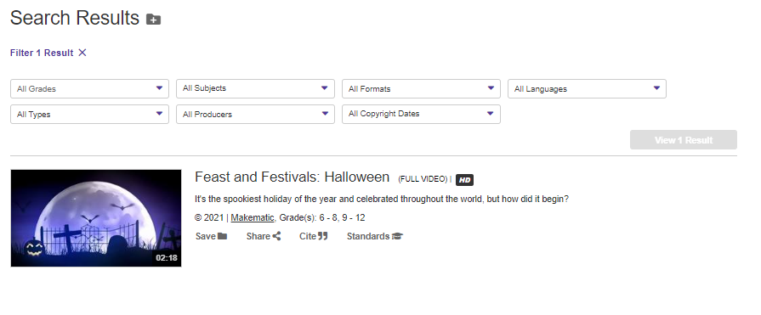
HINT

Slide 11
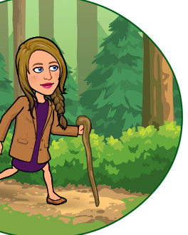
Clue #2
2. What is the item # of Makematic’s Sacagawea title?
__ __ __ __ __ __
1

Slide 12
Clue #2
Directions:
Open Learn360
The key to unlocking this puzzle is to find Lewis and Clark’s interpreter
Search on "interpreter"
You want to find the most recent videos, so sort results by NEWEST to OLDEST.
Hint: You need to click on the title. The item numbers are located under the the title

Slide 13
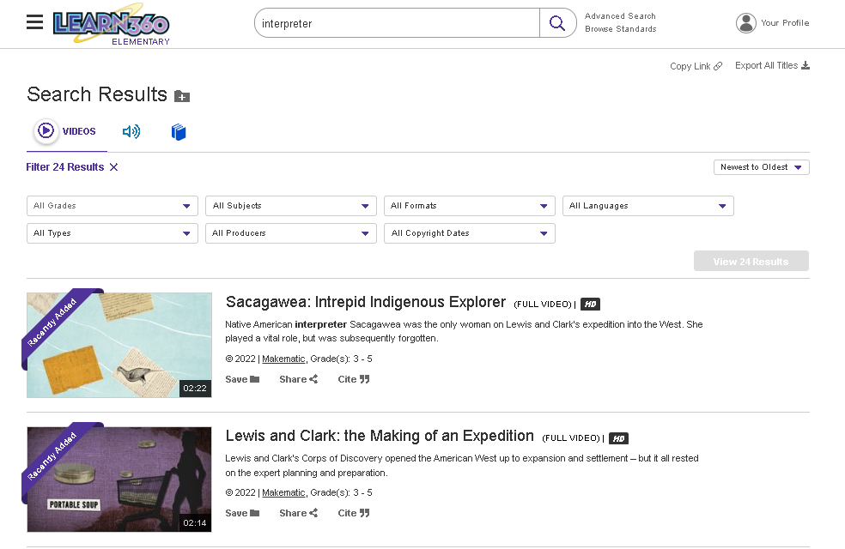
HINT

Slide 14
Clue #3
3. According to the BBC, we should focus on the ?
___ ___ ___ ___ ( ___) ___ ___ (___)

Slide 15
Clue #3
Directions:
Open Learn360
The key to unlocking this puzzle is to find the BBC’s social emotional learning content.
Click “Advanced Search”
Filter by Subject for Social Emotional Learning
Filter by Producer for BBC
Filter by Grade level

Slide 16
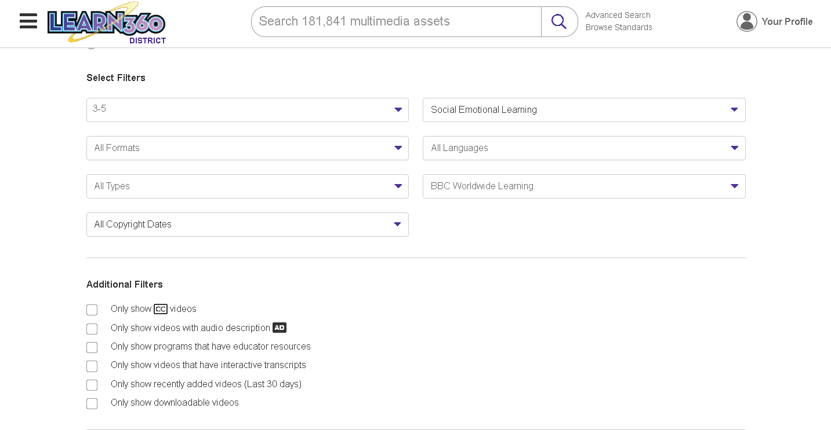
HINT

Slide 17
Clue #4
4. What is the name of the Vooks Storybook available in Spanish?
___ ___ ___ ___ ___ ___ ___ /(___) ___/
___ ___ ___ ___

Slide 18
Clue #4
Directions:
Open Learn360
The key to unlocking this puzzle is to find Vooks Spanish content.
Click “Advanced Search”
Filter by Producer for Vooks
Filter by Language for Spanish

Slide 19
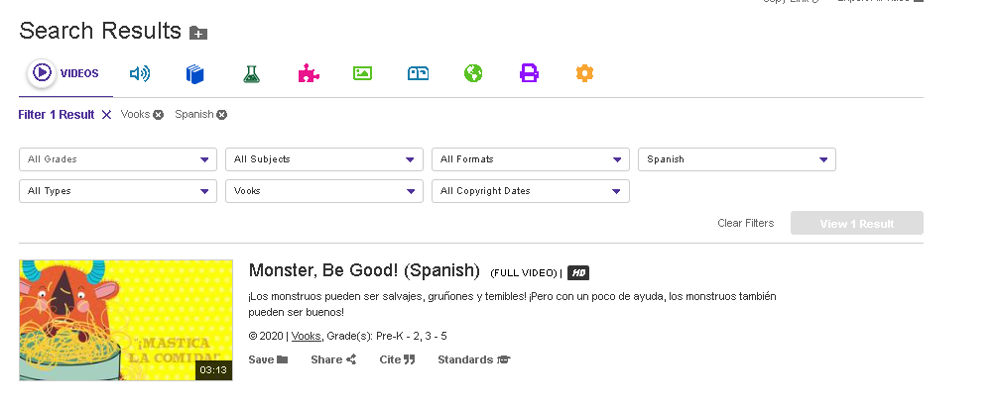
HINT

Slide 20
Clue #5
5. Who is the producer of our Spiders interactive?
___ ___ ___ ___ ___ ___ ___ ___

Slide 21
Clue #5
Directions:
Open Learn360
The key to unlocking this puzzle is to find Learn360’s interactive content
Search spider
Toggle over to Games and Interactives

Slide 22
HINT

Slide 23
Clue #6
6. Where can you find
Trick or Treat printed resources?
____ (____) ___ /___ ___ ___ ___ ___ ( ___) ___

Slide 24
Clue #6
Directions:
Open Learn360
The key to unlocking this puzzle is to find Learn360’s printable content
Search “Trick or Treat”
Toggle over to The Mailbox icon

Slide 25
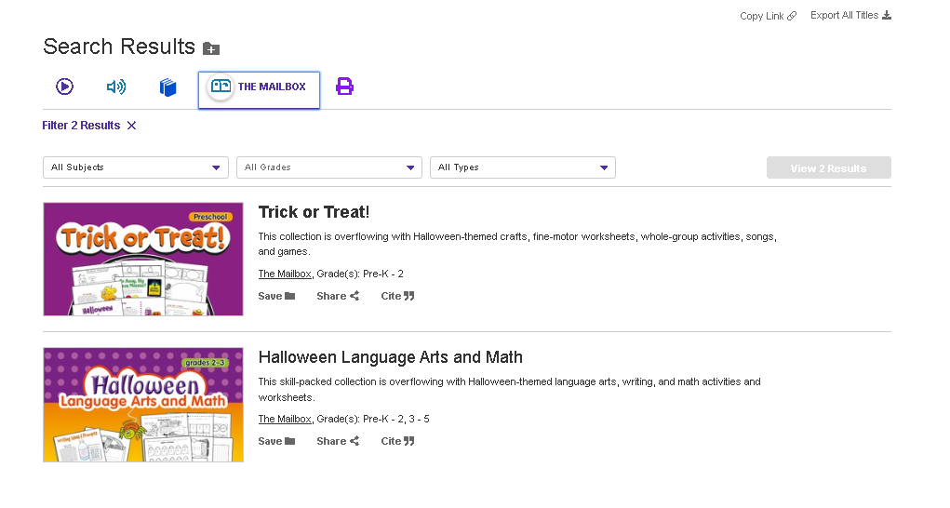
HINT

Slide 26
Clue #7
7. How can you share content?
1. Google Classroom
2. Email
3. Copy link
7. (___) ___ ___ ___ ___

Slide 27
Clue #7
Directions:
To escape, you need to share a Learn360 video or lesson with someone on the outside.
There are 4 different ways you can choose to share with them.
1. Google Classroom
2. Email
3. Copy link
4. (___) ___ ___ (___) ___

Slide 28
HINT

Slide 29
Clue # 8
8. Where do you click to find our Streamable Learning Virtual Field Trips?
__ __ __ (__)

Slide 30
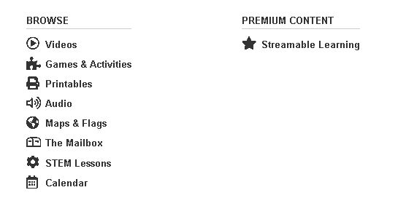
Clue #8
Directions:
To solve this clue, you have to find the premium content.
You have two options:
Click the hamburger menu and scroll over to Premium content
Click the purple star on the toolbar of assets

Slide 31
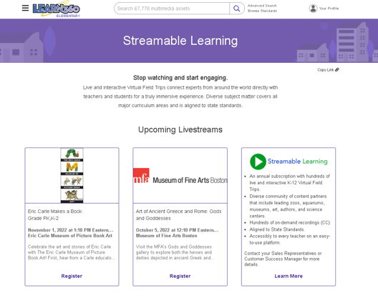
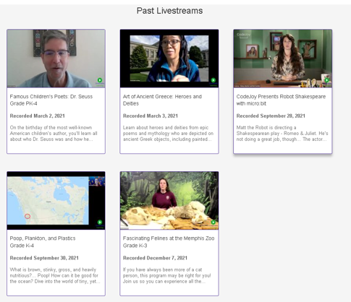
HINT

Slide 32
You’ve made it to the hallway!
but WAIT you forget to send that last parent email
And you left some grading in the classroom
And your coffee cup
And your lunch box
For this next part, you will need to open up
Classroom Video On Demand.
You can access the same features and tools in Classroom Video On Demand that you can in Learn360.
Click the EXIT SIGN and head back in to advance

Slide 33
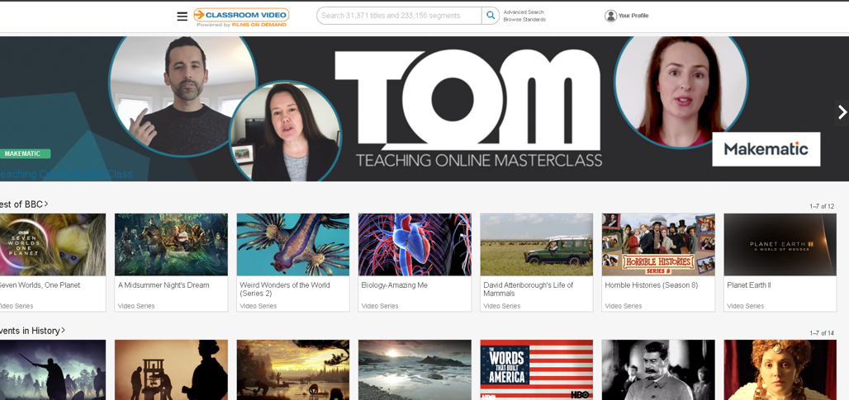
Open up Classroom Video On Demand.
You can access the same features and tools in Classroom Video On Demand that you can in Learn360.

Slide 34
Clue #9
9. Who is the producer of Future of Water?
__ (__)__ __ __ /
__ __ __ __ __ (__)__

Slide 35
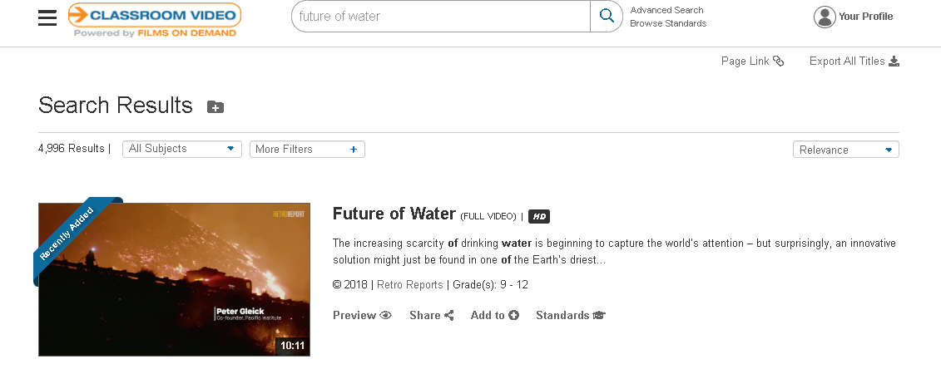
Clue #9
Directions:
Open CVOD.
Type “Future of Water” into the search box

Slide 36
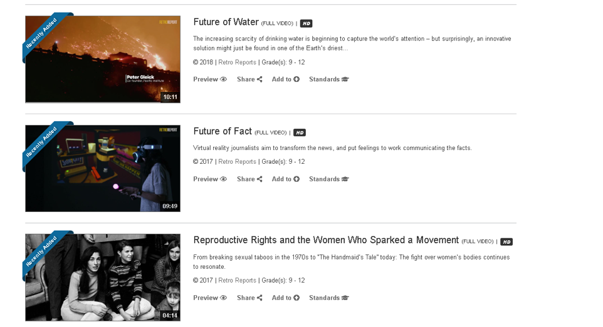
HINT
Copyright, Producer, and Grade level is listed under the description

Slide 37
Clue #10
10. What famous young girl did Barbara Henry teach?
__ __ __ __ /
__ (__) __ __ (__) ___ ___

Slide 38
Clue #10
To solve this clue, you have to open CVOD.
Type “Barbara Henry” into the search box

Slide 39
HINT
The students name is listed in the title.

Slide 40
Clue #11
11. What recently added space technology can you learn about with NOVA?
(__) __ __ __ __ __ __ __ __

Slide 41
Clue #11
Directions
Click “Advanced Search” by the search toolbar
Select Search Options for “Videos”
Select Filters for Producers “NOVA”
Select Filters for Subject “Science”

Slide 42
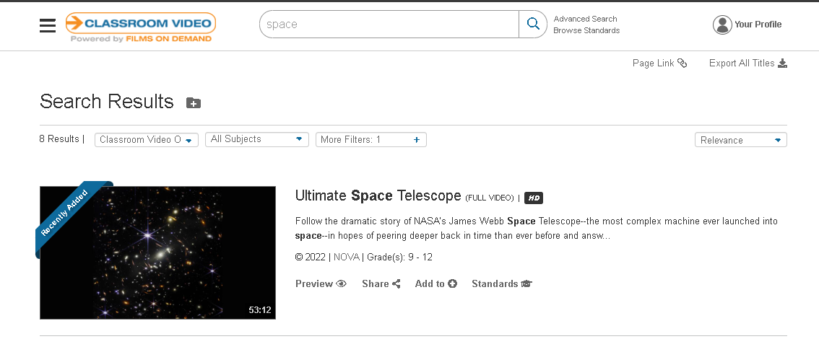
HINT

Slide 43
Clue #12
12. What is our new educator ambassador program called?
___ ___ ___ ___

Slide 44
This is the last puzzle you need to solve in order to escape.
In each of the previous Escape Room puzzles you should have written down the letters that were in parentheses (___) in your answers.
Unscramble those letters now to form a 2 word phrase.
(Hint: Why is diversity a good thing?)
___ ___ ___ ___ ___ ___ / ___ ___ ___ ___ ___ ___ ___ ___
Check your answer with your instructor before advancing

Slide 46
Answer Key
F(e)asts
281858
Posi(t)iv(e)
Monster, (B)e Good
Nussbaum
T(h)e Mailb(o)x
7. (e)mbed
8. Sta(r)
9. R(e)tro Repor(t)s
10. Ruby B(r)id(g)es
11. (T)elescope
12. LEAP
Final: e t e B h o e r e t r g T

Slide 47
How to Design Your Own Escape Room
Create a new powerpoint
Search Google for background images
Search Images
Click Tools
Click Image Rights
Set the background of your first slide as the image you selected
Find more images to add to your background
Remove background from the images
Insert links on each image connecting images to various slides.
Remember to link back to original escape room and exit signs.

Slide 48
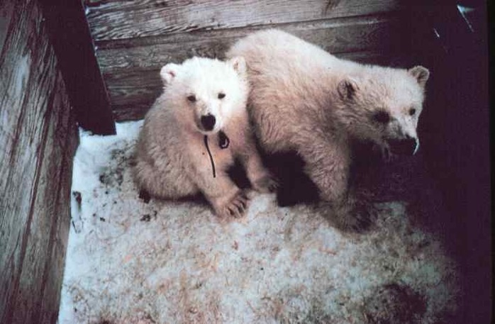
Ideas for Student Created Escape Rooms
Escape the Zoo
Escape the Wax Museum
Escape the World Fair
Escape the Sphinx
Escape the Roman Ruins
Escape Indoor Recess
Escape Global Warming

Slide 49
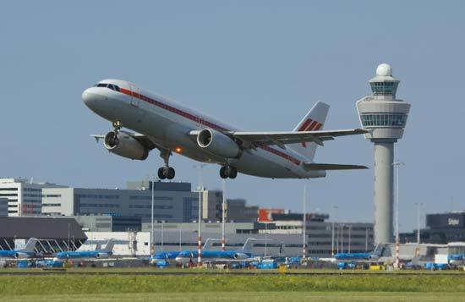
Ideas for Student Created Escape Rooms
Escape the Butterfly House
Escape the Botanical Gardens
Escape to Outer Space
Escape the Desert
Escape the Library
Escape Letterland
Escape the Airport

Slide 50
Item #s
How to Set Goals, 281854, 2022, Learn360, CVOD
Feast and Festivals: Halloween, 277092, 2021, Learn360
Sacagawea: Intrepid Indigenous Explorer, 281858, 2022, CVOD, Learn360
Focus on the Positive, 215503, 2020 Learn360, JFK
Monster, Be Good! (Spanish), 279713, Learn360, JFK
Spiders- Interactives, 110103,2022, Learn360
Trick or Treat, 211586, The Mailbox, Learn360
Future of Water, 281612, 2018, CVOD
Barbara Henry: Teaching Ruby Bridges, 281873, 2022, Learn360, CVOD
Ultimate Space Telescope, 281724, 2022, CVOD
Polar Bear Cubs to the Zoo, 103380, Learn360
Airport, 127629, Learn360

Slide 51
Thank you!
Emily Ice, K-12 Video Acquisition Manager
eice@infobase.com
NEW! Learn360 Educator Ambassador Program
LEARN MORE with webinars and blogs

